Slide 1
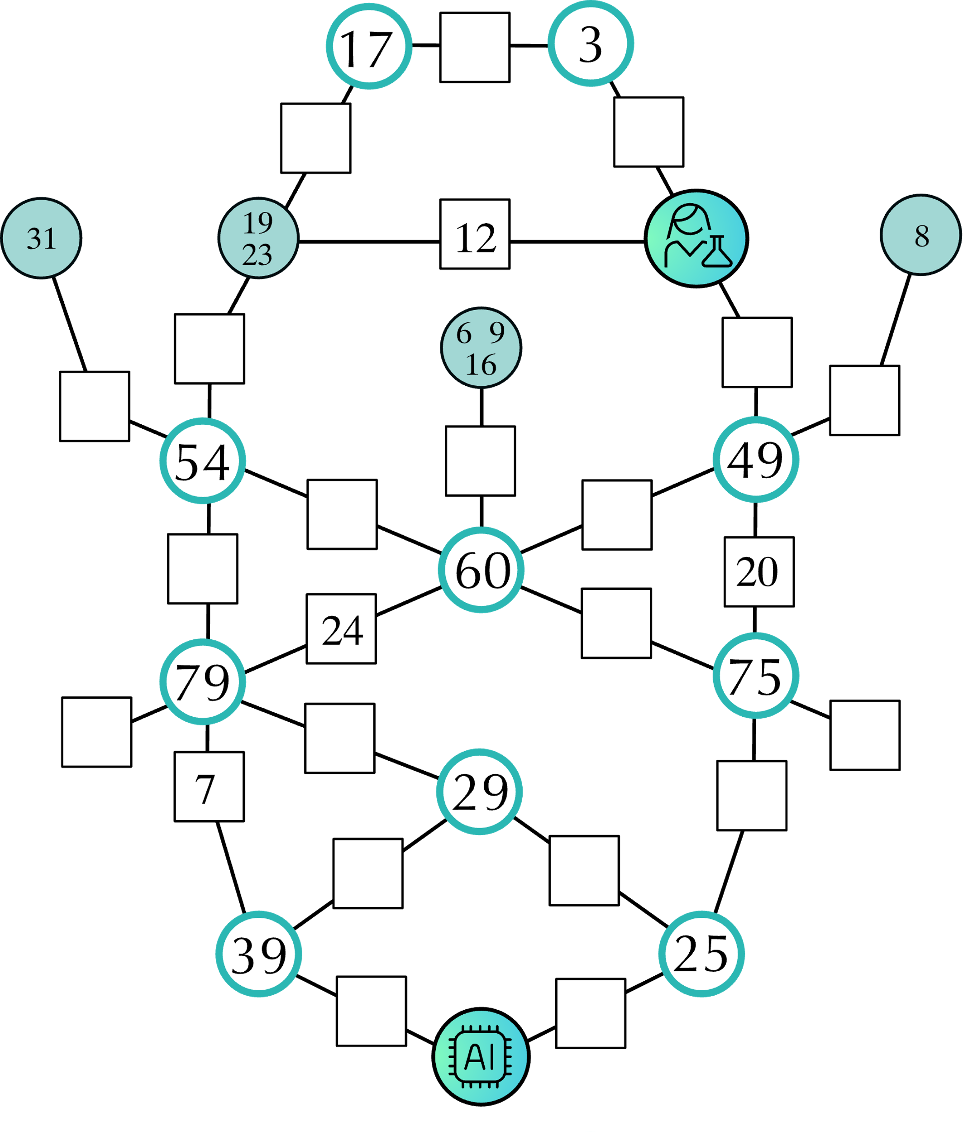




Can you solve this riddle?
Fill all edges of this graph with the number 1 to 24. Each number can only be used one. The numbers 7, 12, 20, and 24 are already given.
The nodes provide additional constraints:
The number inside this node denotes the sum of all edges directly connected to it.
There exists a non-intersecting path starting from this node with the sum of the weights of the edges along that path equaling the number within this node. Multiple numbers refer to multiple paths (may overlap).
Once you filled all edges find the shortest weighted path from the scientist to the AI-chip and convert it to letters (1=A, 2=B etc.) to reveal the secret message.

